Slide 1
COMMISSIONER CABINET
Monthly Training

Slide 2
JOHN NEUHAUS
District Commissioner
How To Perform A
Uniform Inspection

Slide 3
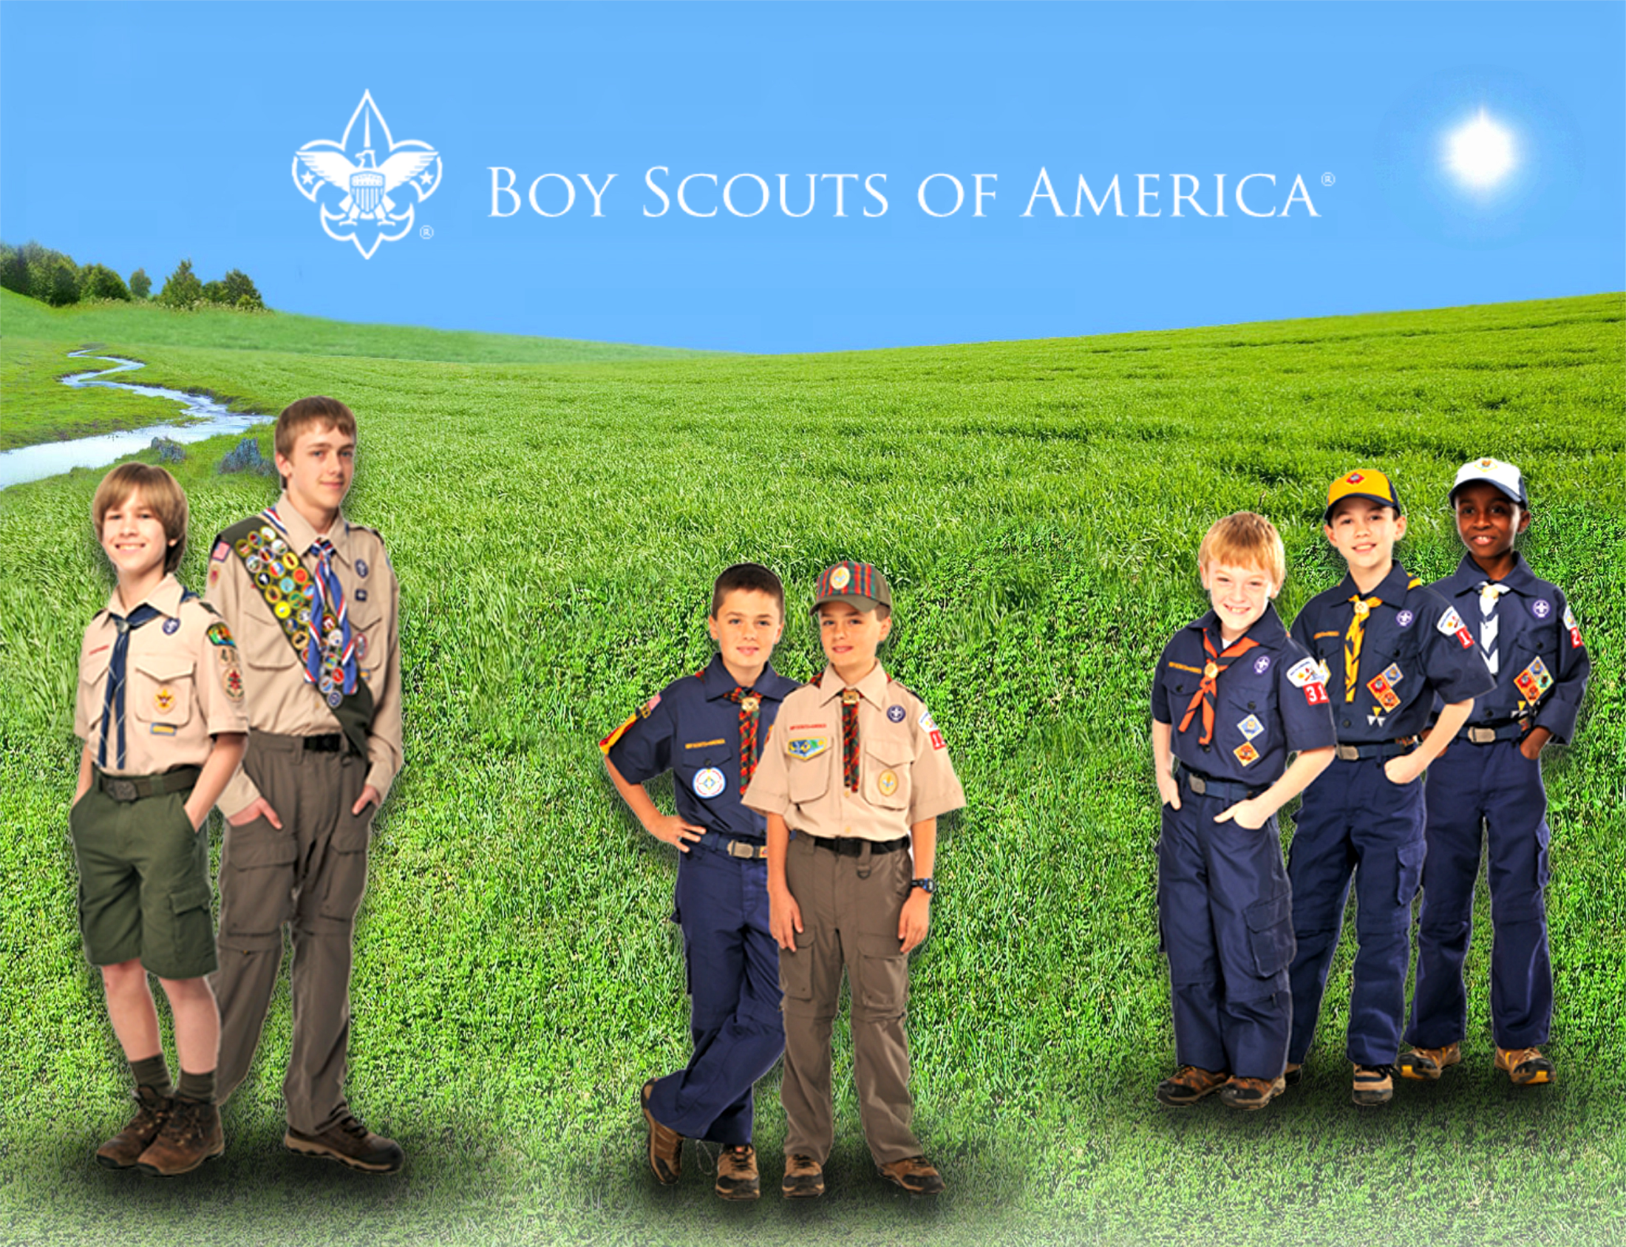
Notes:
The Boy Scouts of America has always been a uniformed body. Its uniforms help to create a sense of belonging. They symbolize character development, citizenship training, and personal fitness. Wearing a uniform gives youth and adult members a sense of identification and commitment.
Personal equality - The uniform represents a democratic idea of equality, bringing people of different backgrounds together in the Scouting tradition.
Identification - The uniform identifies youth and adult members of the Boy Scouts of America, visible as a force for good in the community. When properly and smartly worn, the uniform can build good unit spirit.
Achievement - The uniform shows the wearer's activity, responsibility, and achievement. The accomplishments of every youth and adult member can be recognized by the insignia worn on the uniform.
Personal commitment - The uniform is a constant reminder to all members of their commitment to the ideals and purpose of the Scouting movement. It is a way of making visible members' commitment to a belief in God, loyalty to country, and helping others at all times.

Slide 4
Uniform Inspection
Set the Example!
Perfect uniform score
Modest display of badges
Commissioner’s badges should reflect service at Council or District level
Consider no more than 9 knots (BSA Guide to Awards & Insignia – P61)
Notes:
Commissioners set a personal example with correct uniforming and a modest display of badges.
What is a modest display of badges?
It has often been said that unit leaders wear most of their badges on the uniforms of their youth members.
It might also be said that commissioners wear most of their badges on the uniforms of their unit leaders.
Most of a commissioner’s badges should reflect their service at a council or district level.
For example, they proudly wear the JTE District emblem, but good taste might dictate that they refrain from wearing the JTE Unit emblem simply because they serve on the troop committee of their son’s JTE troop.
Insignia Guide – Page 61 “It is recommended that the number of knots be limited to three rows of three (a total of nine knots).”

Slide 5
Uniform Inspection
While Scouters may wear the insignia to which they are entitled, a ‘total display’ may not be in the best taste if the uniform looks overcrowded.
The Commissioner who wears only his Commissioner emblem, council shoulder patch and service star on his uniform is never guilty of poor taste.
Notes:
Set the Example!
While Scouters may wear the insignia to which they are entitled, a ‘total display’ may not be in the best taste if the uniform looks overcrowded.
The Commissioner who wears only his Commissioner emblem, council shoulder patch and service star on his uniform is never guilty of poor taste.
SOURCE: Scoutmaster Handbook – replacing Scoutmaster with Commissioner.

Slide 6
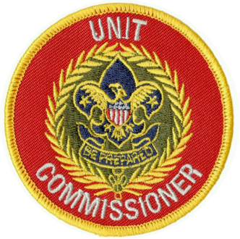
Uniform Inspection
Who:
Unit Commissioner
Integral part of Annual Commissioner Service Plan
Notes:
The commissioner helps pack and troop leaders and lends dignity to a high-morale event.

Slide 7
Uniform Inspection
Why:
Encourages complete uniforms
Persuade new members to obtain a uniform
Develops unit pride
Notes:
The Scouting movement is built on positive values, as reflected in a properly worn uniform.
A uniform inspection helps Boy Scouts take pride in themselves and their appearance, and shouldn't be used as a way to degrade a member.
Inspections are also a great opportunity to:
Encourage a complete uniform for all members.
Develop unit pride.

Slide 8
Uniform Inspection
When:
Cub Scout Packs - Fall
Boy Scout Troops – Spring & Fall
Venturing Crews – Never*
At the request of the unit leader
Notes:
When:
Cub Scout Packs - Fall
Boy Scout Troops – Spring & Fall
Venturing Crews – Never (generally)
Uniforms are NOT one of the methods of Venturing – but units who choose to wear uniforms should wear them properly.
Occasionally you will be asked to inspect the unit.

Slide 9
Uniform Inspection
How:
Obtain a supply of inspection sheets
2x each youth/adult
Supply unit leader with a set
Unit Leader distributes sheets 7-14 days before inspection
Members are instructed to take home and check their uniforms
Notes:
How:
Friendly but dignified manner
Use common sense
Basic rule is neatness
Positive experience
Never embarrass or ridicule!

Slide 10
Uniform Inspection
How:
Short & Snappy
Friendly but dignified manner
Use common sense
Basic rule is neatness
Positive experience
Notes:
How:
Short & Snappy
They are morale features rather than major parts of unit meetings.
Conduct inspection in a friendly but dignified manner
Use common sense
Basic rule is neatness
Make it a positive experience Never embarrass or ridicule!

Slide 11
Uniform Inspection
How:
Involve Pack or Troop leaders
SPL with you to inspect Troop
PL with you to inspect Patrol
DC with you for their Dens
Notes:
How:
Involve Pack or Troop leaders
SPL with you to inspect Troop
PL with you to inspect Patrol
DC with you for their Dens

Slide 12
Uniform Inspection
How:
Use unit committee members as inspecting officers
Work in teams.
One check uniforms
One inspect insignia
Notes:
How:
Use unit committee members as inspecting officers
Work in teams.
One check uniforms
One inspect insignia
NOTE: in larger troops, consider inviting other Commissioners to help you!

Slide 13
Uniform Inspection
How:
Use inspection sheets
Find things to compliment during inspection
Brief complimentary statement at end
Notes:
How:
Use inspection sheets
Find things to compliment during inspection
Brief complimentary statement at end

Slide 14
Uniform Inspection
How:
Follow up with unit leaders on any serious uniform issues
Review leader uniforms in private
Notes:
How:
Follow up with unit leaders on any serious uniform issues
Review leader uniforms in private

Slide 15
Uniform Inspection
What about!?
Boys without Uniforms?
Leaders who aren’t properly uniformed
When to wear the uniform
When not to wear uniform
Notes:
Remember: a boy is not required to have a uniform to be a Boy Scout
Uniform Exchange
Leaders – DISCUSS!
Be knowledgeable about WHEN to wear the uniform:
All Scout activities == we used to say “indoor” activities and use a Field Uniform for physically active outdoor events.
The new Centennial Uniform is made for outdoor activity with high-tech features that emphasize flexibility, durability, easy care, and functionality. Field Uniforms can be still used for informal events.
Be knowledgeable about when NOT to wear the uniform:
When selling a commercial product or service (except popcorn)
Situations that might imply endorsement by the BSA
When engaged in an activities that could dishonor or discredit the BSA or the person wearing the uniform.

Slide 16
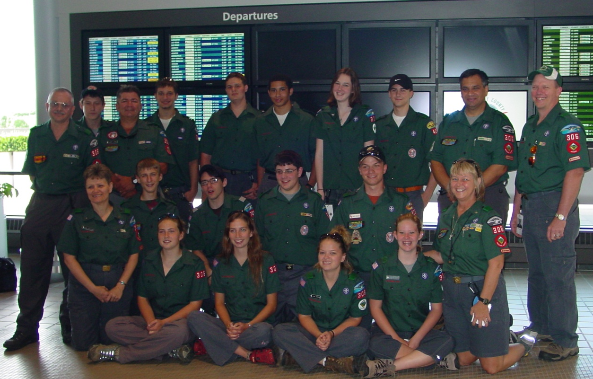
Uniform Inspection
What about!?
Uniforms when travelling
Notes:
Uniforms when travelling –
There is a rule that says you can’t wear the uniform outside the US without a Letter of Introduction or as part of a group travelling on a tour permit.
There are no rules preventing a Scout unit from wearing their uniforms when they travel OR requiring them to wear a uniform. Sometimes the unit leader will place “requirements” on their boys…
While not required, it looks great if they wear the uniform as they travel together as a unit. Of course in that case, they must have a tour permit.

Slide 17
Uniforms
Where does this go?!
Notes:
NEW - Amateur Radio Operator Rating Strip
For registered youth or adult member with a valid amateur radio license, of any class, issued by the Federal Communications Commission (FCC).

Slide 18
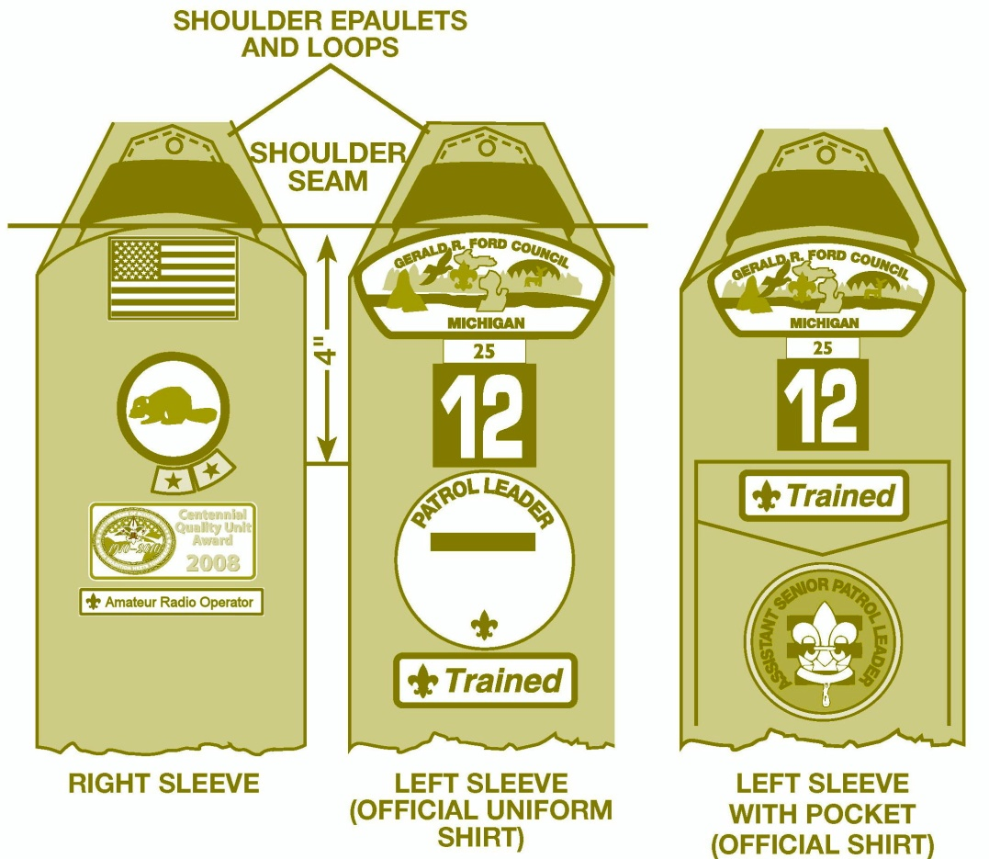
Uniforms
Right sleeve
Notes:
Strip on your right sleeve, below the U.S. flag, patrol/den emblem, and a unit award, if you have one.

Slide 19
Uniforms
Extra points – where does this go?
Notes:
MORSE

Slide 20
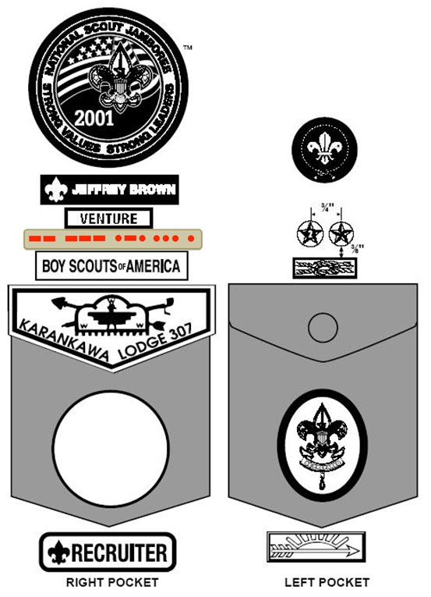
Uniforms
Right pocket
Notes:
WHY? Morse Code is considered an interpreter strip.

Slide 21
Uniforms
Notes:
Anyone want to try Sea Scout Uniforms?!

Slide 22
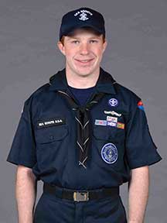
Uniforms
Notes:
Actually…. The Sea Scout Uniforms just became easier!!! This is the newest uniform in the bsa!
Called the New Century Universal Sea Scout Uniform”
It is intended to make it easy for members of newly formed Sea Scout Ships to outfit themselves in a Sea Scout uniform and may be chosen by any unit new or existing.
New Century Universal Sea Scout Uniform Components
Navy Blue ball cap; with SEA SCOUTS and the Sea Scout First Class Anchor embroidered in white. Youth may wear the white Dixie cup (unit option) and adults may wear the white combination cover (unit option)
Dark Navy Blue shirt (similar to Dickies Nos.1574(male) and FS574(female), color DN)
Dark Navy Blue crew-neck t-shirt
Optional neckerchief for youth (unit option) either the New Century Neckerchief (black “tar flap” design), or Sea Scout Neckerchief (triangular black with white embroidered Sea Scout First Class Anchor and edging)
Dark Navy Blue trousers (similar to Dickies Nos. 874(male) and 774 (female); color DN)
Black web belt with silver buckle and tab
Black plain-toe shoes and black sock

Slide 23
Uniform Inspection
Resources
#33066 Guide to Awards & Insignia
Uniform Inspection Sheets
34282 Tiger-Wolf-Bear
34760 Webelos
34283 Boy Scout-Varsity
34048 Leader
Notes:
Commissioner-BSA.org
Right under the training PowerPoint

Slide 24
Questions?

